Slide 1


Signs, Signals, and Codes Merit Badge
Troop 344/9344
Pemberville, OH

Slide 2

Signs, Signals, and Codes Merit Badge Requirements
Discuss with your counselor the importance of signs, signals, and codes, and why people need these different methods of communication. Briefly discuss the history and development of signs, signals, and codes.
Explain the importance of signaling in emergency communications. Discuss with your counselor the types of emergency or distress signals one might use to attract airborne search-and-rescue personnel if lost in the outdoors or trying to summon assistance during a disaster. Illustrate these signaling examples by the use of photos or drawings.

Slide 3

Signs, Signals, and Codes Merit Badge Requirements
Do the following:
  Describe what Morse code is and the various means by which it can be sent. Spell your first name using Morse code. Send or receive a message of six to 10 words using Morse code.
  Describe what American Sign Language (ASL) is and how it is used today. Spell your first name using American Sign Language. Send or receive a message of six to 10 words using ASL.
Give your counselor a brief explanation about semaphore, why it is used, how it is used, and where it is used. Explain the difference between semaphore flags and nautical flags. Then do the following:
  Spell your first name using semaphore. Send or receive a message of six to 10 words using semaphore.
  Using illustrations or photographs, identify 10 examples of nautical flags and discuss their importance.

Slide 4
Signs, Signals, and Codes Merit Badge Requirements
Explain the braille reading technique and how it helps individuals with sight impairment to communicate. Then do the following:
  Either by sight or by touch, identify the letters of the braille alphabet that spell your name. By sight or touch, decode a braille message at least six words long.
  Create a message in braille at least six words long, and share this with your counselor.
Do the following:
  Describe to your counselor six sound-only signals that are in use today. Discuss the pros and cons of using sound signals versus other types of signals.
  Demonstrate to your counselor six different silent Scout signals. Use these Scout signals to direct the movements and actions of your patrol or troop.

Slide 5
Signs, Signals, and Codes Merit Badge Requirements
On a Scout outing, lay out a trail for your patrol or troop to follow. Cover at least one mile in distance and use at least six different trail signs and markers. After the Scouts have completed the trail, follow no-trace principles by replacing or returning trail markers to their original locations.
For THREE of the following activities, demonstrate five signals each. Tell what the signals mean and why they are used:
  Sports official's hand signs/signals
  Heavy-equipment operator's hand signals
  Aircraft carrier catapult crew signals
  Cyclist's hand signals
  An activity selected by you and your counselor

Slide 6
Signs, Signals, and Codes Merit Badge Requirements
Share with your counselor 10 examples of symbols used in everyday life. Design your own symbol. Share it with your counselor and explain what it means. Then do the following:
  Show examples of 10 traffic signs and explain their meaning.
  Using a topographical map, explain what a map legend is and discuss its importance. Point out 10 map symbols and explain the meaning of each.
  Discuss text-message symbols and why they are commonly used. Give examples of your favorite 10 text symbols or emoticons. Then see if your counselor or parent can identify the meaning or usage of each symbol.
Briefly discuss the history of secret code writing (cryptography). Make up your own secret code and write a message of up to 25 words using this code. Share the message with a friend or fellow Scout. Then share the message and code key with your counselor and discuss the effectiveness of your code.

Slide 7
Requirement 1
Discuss with your counselor the importance of signs, signals, and codes, and why people need these different methods of communication. Briefly discuss the history and development of signs, signals, and codes.

Slide 8
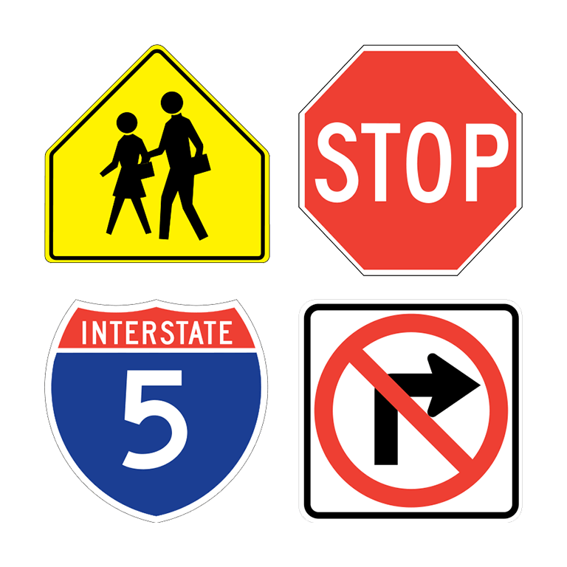
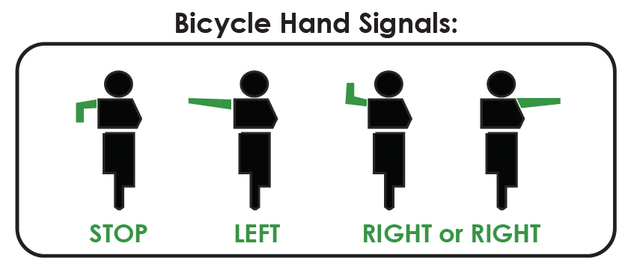
Importance of Signs,
Signals, and Codes
Signs are any kind of visual graphics created to display information to people.
A signal is something someone does to pass on information. This can be anything from a hand gesture to spoken words.
Signs and signals help people understand that world. The main purpose of signs and signals is to communicate, to convey information designed to assist the receiver with decision-making based on the information provided.

Slide 9
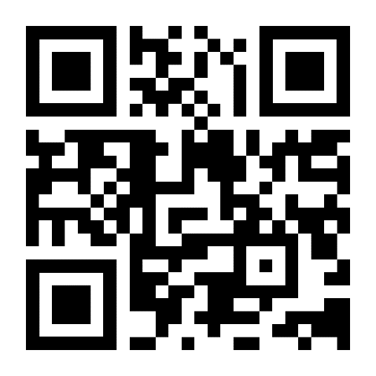
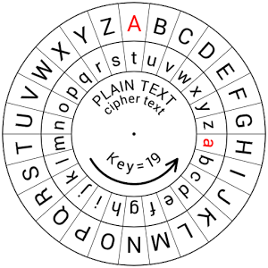
Importance of Signs,
Signals, and Codes
A code is a system of symbols, letters, words, or signals that are used instead of ordinary words and numbers to send messages or store information.
Codes and ciphers are forms of secret communication. A code replaces words, phrases, or sentences with groups of letters or numbers, while a cipher rearranges letters or uses substitutes to disguise the message. The technology of such secret communication is called cryptology.

Slide 10
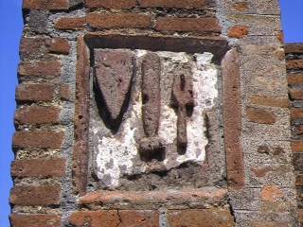
Importance of Signs,
Signals, and Codes
The first signals probably grew out of people’s gestures.
Signs, as we know of today, started around the time of the Greek, Roman and Egyptian cities, dating from about 3000 B.C. and beyond. Most of these signs were made of stone or terra cotta with the use of imagery more than text, since, many people were illiterate, during, that time.
Codes and secret writing has been employed about as long as writing has existed. Cryptology has long been employed by governments, military, businesses, and organizations to protect their messages. Today, encryption is used to protect storage of data and transactions between computers.
Stone mason sign from Pompeii

Slide 11
Requirement 2
Explain the importance of signaling in emergency communications. Discuss with your counselor the types of emergency or distress signals one might use to attract airborne search-and-rescue personnel if lost in the outdoors or trying to summon assistance during a disaster. Illustrate these signaling examples by the use of photos or drawings.

Slide 12

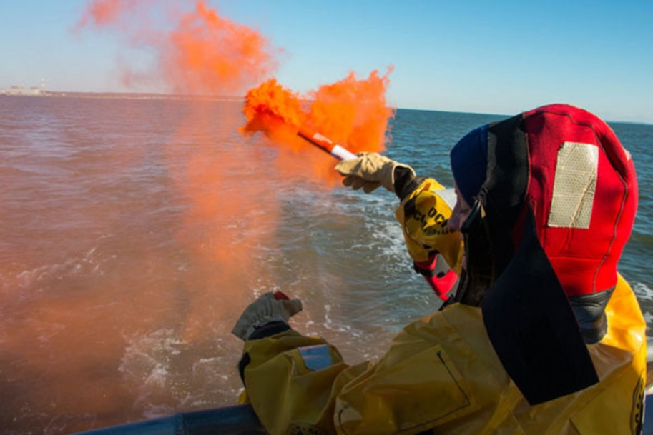
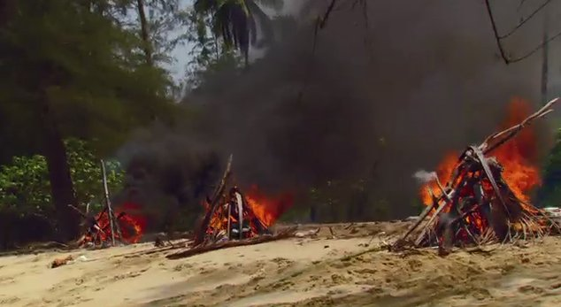
Signaling in Emergencies
Knowing basic rescue signals could save your life or the life of others.
To attract the attention of rescuers, use signals to make yourself audible or visible.

Slide 13
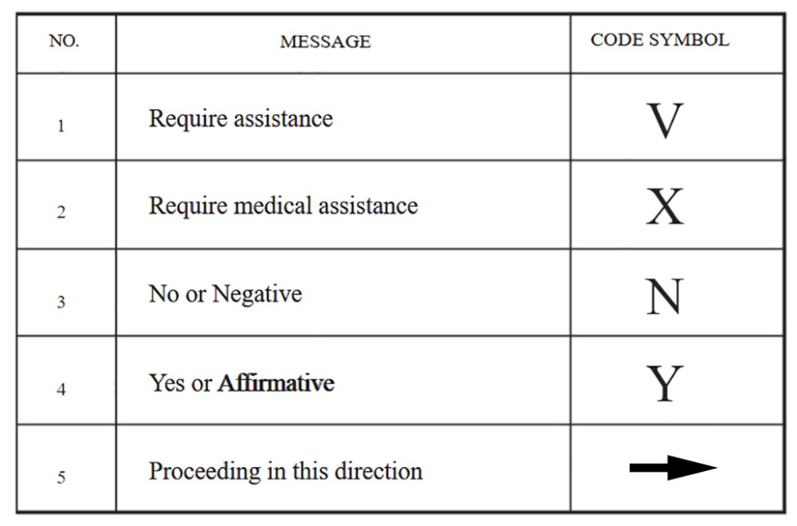
International Ground-to-Air Signaling Code
There are many instances where self-rescue may not be possible.
We often over-confidently assume we'll be able to make it to safety under our own power, but if something catastrophic happens, you'd better know how to call for help.
You should know the international ground-to-air signaling code.
This standard system is designed to send a clear visual message to any aircraft that might pass your location.
These letters should be constructed on a clear patch of ground, with as much contrast between the symbols and backdrop as possible.
Make the symbol as large as you can — at least 10 feet wide is recommended.

Slide 14
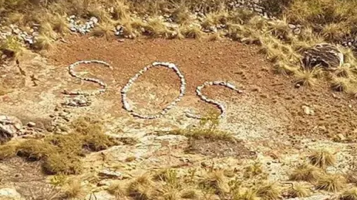
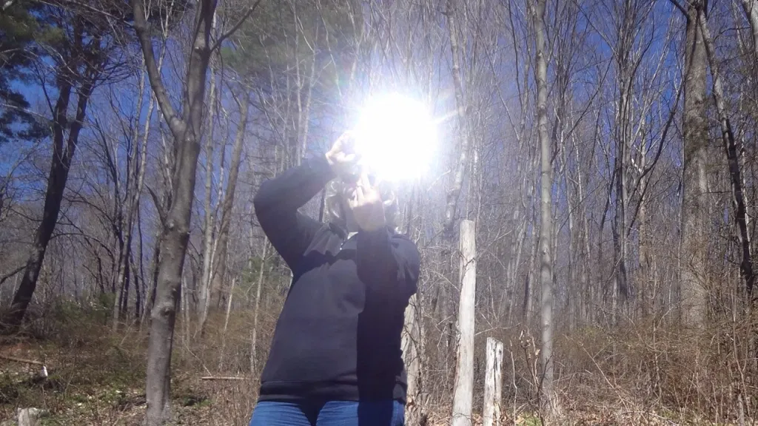
Other Types of Ground Signals
Spelling out Letters: You can spell out the word SOS (Save Our Souls)
Whistle blasts: Whistle blast are useful for alerting ground units that you are close to them. However, you can also give three loud blasts of a whistle at varying times of the day and night, to signal your location. Even if search teams are not in your area, someone else maybe close by and hear the whistle – which will alert them to your presence.
Signal Mirror: Signal mirrors can be used to alert aircraft flying overhead as to your location. They are designed so that the mirror emits a cone shaped light ray which gets the pilots attention. When the pilot sees the mirror flashes, they can get a fix on your location, due to the unique design.

Slide 15
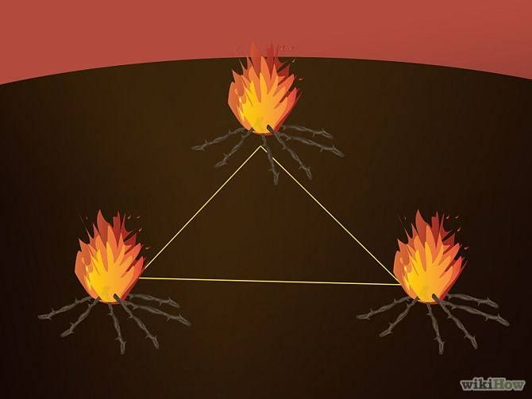
The Rule of 3's in Distress Signals
Most distress signals are given in a sequence of 3’s, for instance – three whistle blasts, three glints from a mirror, three fires arranged in a triangle shape and so on.

Slide 16
Requirement 3
Do the following:
  Describe what Morse code is and the various means by which it can be sent. Spell your first name using Morse code. Send or receive a message of six to 10 words using Morse code.
  Describe what American Sign Language (ASL) is and how it is used today. Spell your first name using American Sign Language. Send or receive a message of six to 10 words using ASL.

Slide 17
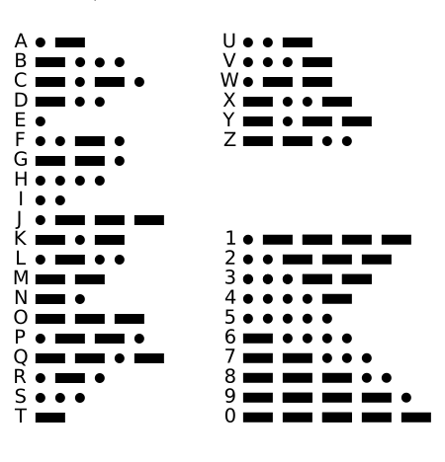
Morse Code
The Morse code is a code that uses a series of dots and dashes to represent the different letters of the alphabet and numbers.
The various letters, numbers and other characters are made up by combining these two elements in different combinations.

Slide 18
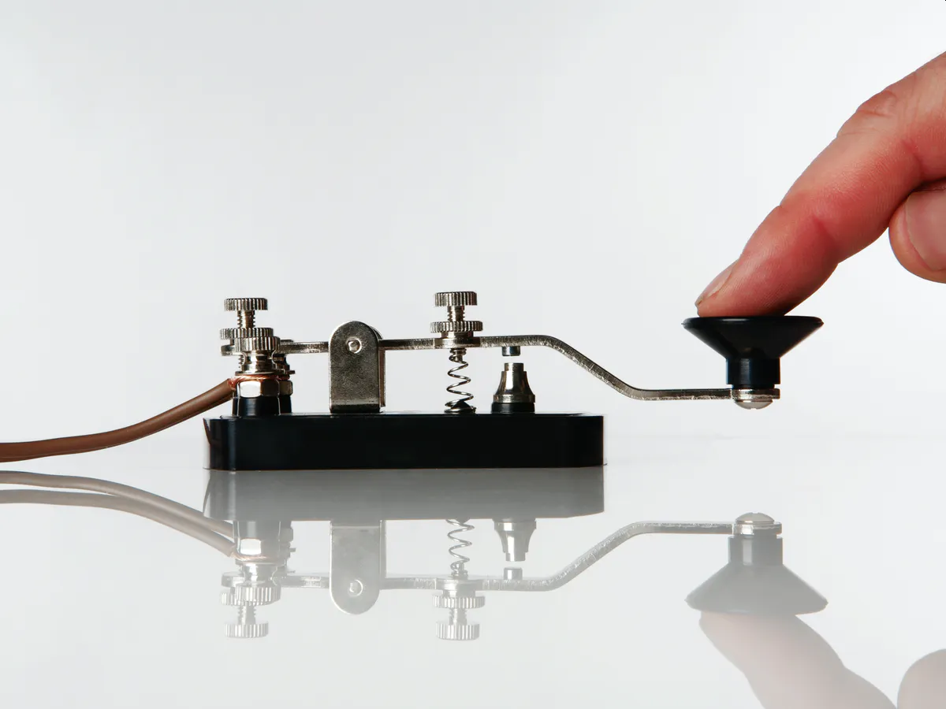
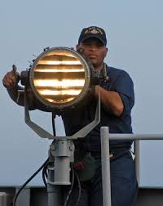
Morse Code
Morse code is usually transmitted by on-off keying of an information-carrying medium such as electric current, radio waves, visible light, or sound waves.
The current or wave is present during the time period of the dot or dash and absent during the time between dots and dashes.

Slide 19

American Sign Language (ASL)
American Sign Language (ASL) is a visual language.
With signing, the brain processes linguistic information through the eyes.
The shape, placement, and movement of the hands, as well as facial expressions and body movements, all play important parts in conveying information.
Each country has its own sign language, and regions have dialects, much like the many languages spoken all over the world.
Like any spoken language, ASL is a language with its own unique rules of grammar and syntax.
Like all languages, ASL is a living language that grows and changes over time.
ASL is used predominantly in the United States and in many parts of Canada.
A young boy signs "I love you."

Slide 20
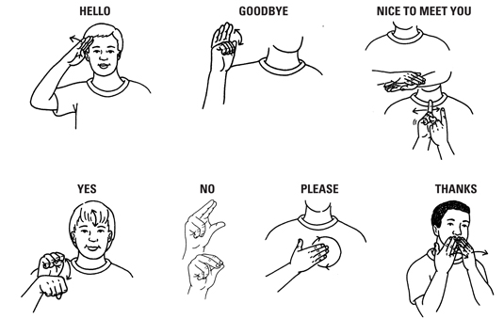
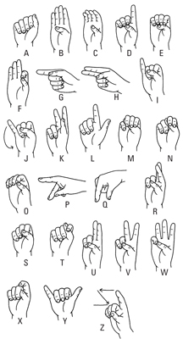
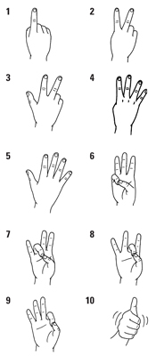
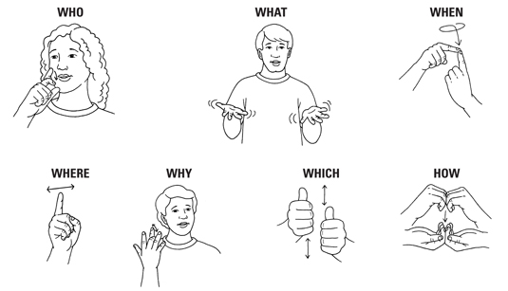
American Sign Language Cheat Sheet
If you don’t know the sign for something, you need to use the manual alphabet to spell the word, or fingerspell.

Slide 21
Requirement 4
Give your counselor a brief explanation about semaphore, why it is used, how it is used, and where it is used. Explain the difference between semaphore flags and nautical flags. Then do the following:
  Spell your first name using semaphore. Send or receive a message of six to 10 words using semaphore.
  Using illustrations or photographs, identify 10 examples of nautical flags and discuss their importance.

Slide 22
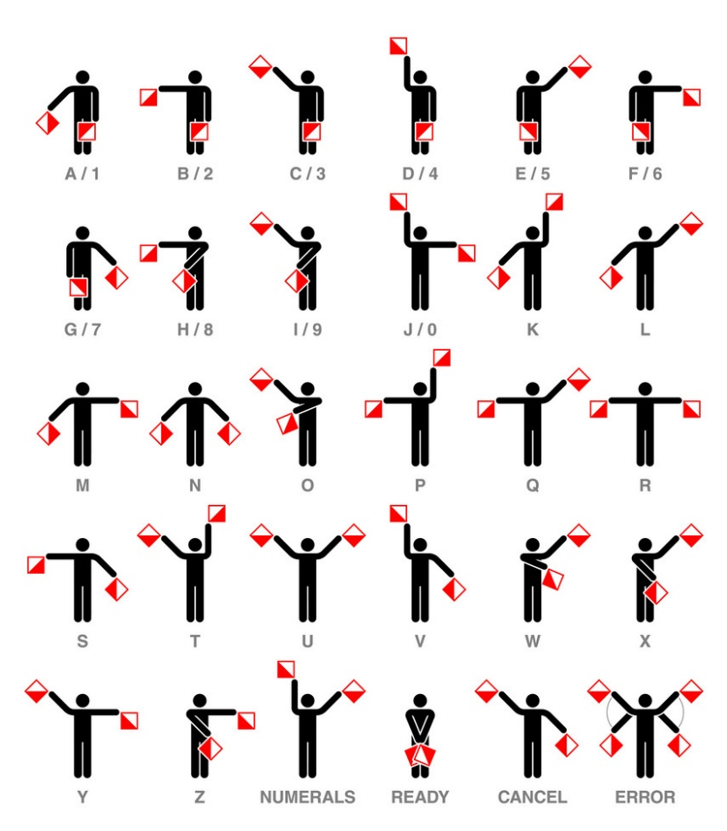
Semaphore
The Semaphore flag signaling system is an alphabet signaling system based on the waving of a pair of hand-held flags in a particular pattern.
The flags are usually square, red and yellow, divided diagonally with the red portion in the upper hoist.

Slide 23
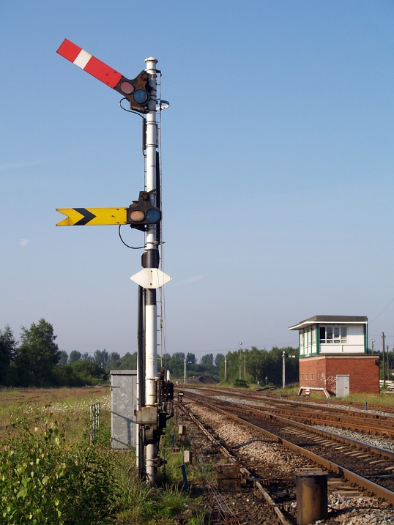
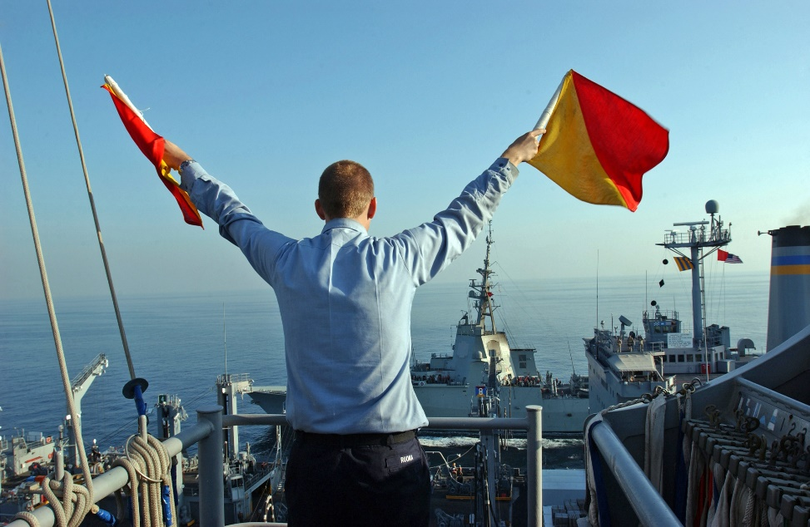
Semaphore
Before the invention of the telegraph, semaphore signaling from high towers was used to transmit messages between distant points.
Modern semaphores included movable arms or rows of lights simulating arms, displayed from towers and used to signal railroad trains.
Semaphores were adopted and widely used in the maritime world in the 19th century.
Flag semaphore is still in use by the Navy and also continues to be a subject of study and training for Scouts.

Slide 24
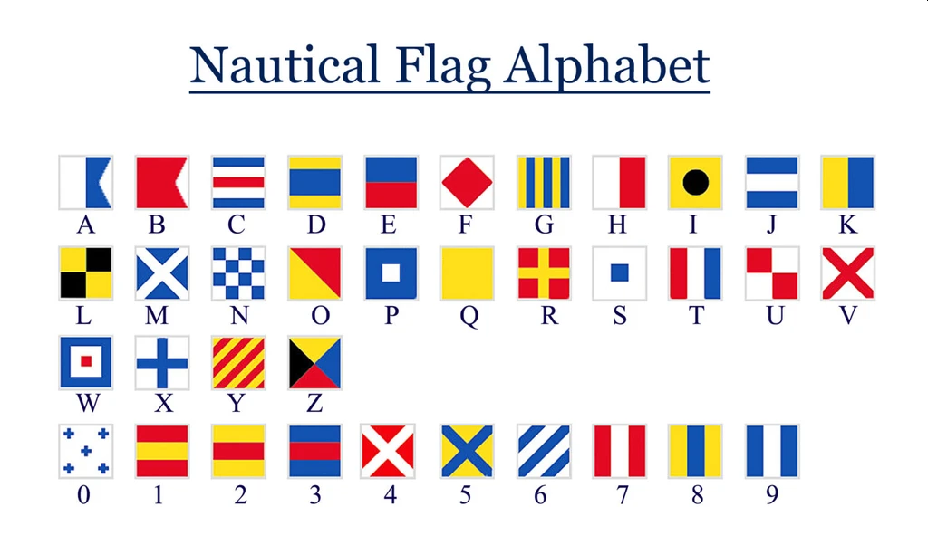
Nautical flags are an international code system used for two ships to signal to each other or for a ship to signal to shore.
Nautical flags are made up of 26 square flags (which represent the letters of the alphabet) along with 10 numbered pendants
For easy recognition nautical flags are either red and white, yellow and blue, blue and white, black and white along with plain red, white and blue.
Nautical flags and the knowledge of their meanings are valuable at sea in case of danger or breakdowns in other communications systems such as radio.

Slide 25
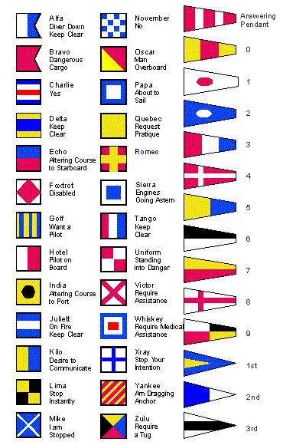
Nautical Flags
Solo or combined, nautical flags convey meaning.
For example, if you see the A (Alpha) flag, this means “diver down, keep clear.”
If you see the W (Whiskey) flag, the boat has a medical emergency and needs help.
The combination of the D (Delta) and V (Victor) flags, meanwhile, means “I’m maneuvering with difficulty and require assistance.”
The J (Juliet) and L (Lima) flags mean “you’re running the risk of going aground.”
Signals with two nautical flags typically mean some type of distress or maneuvering issue.

Slide 26
Requirement 5
Explain the braille reading technique and how it helps individuals with sight impairment to communicate. Then do the following:
  Either by sight or by touch, identify the letters of the braille alphabet that spell your name. By sight or touch, decode a braille message at least six words long.
  Create a message in braille at least six words long, and share this with your counselor.

Slide 27
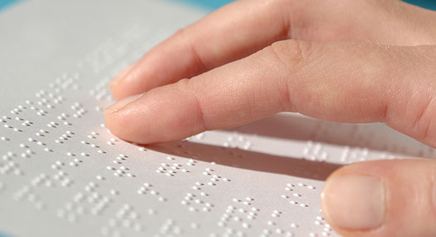
Braille
Braille is a system of raised dots that can be read with the fingers by people who are blind or who have low vision.

Slide 28
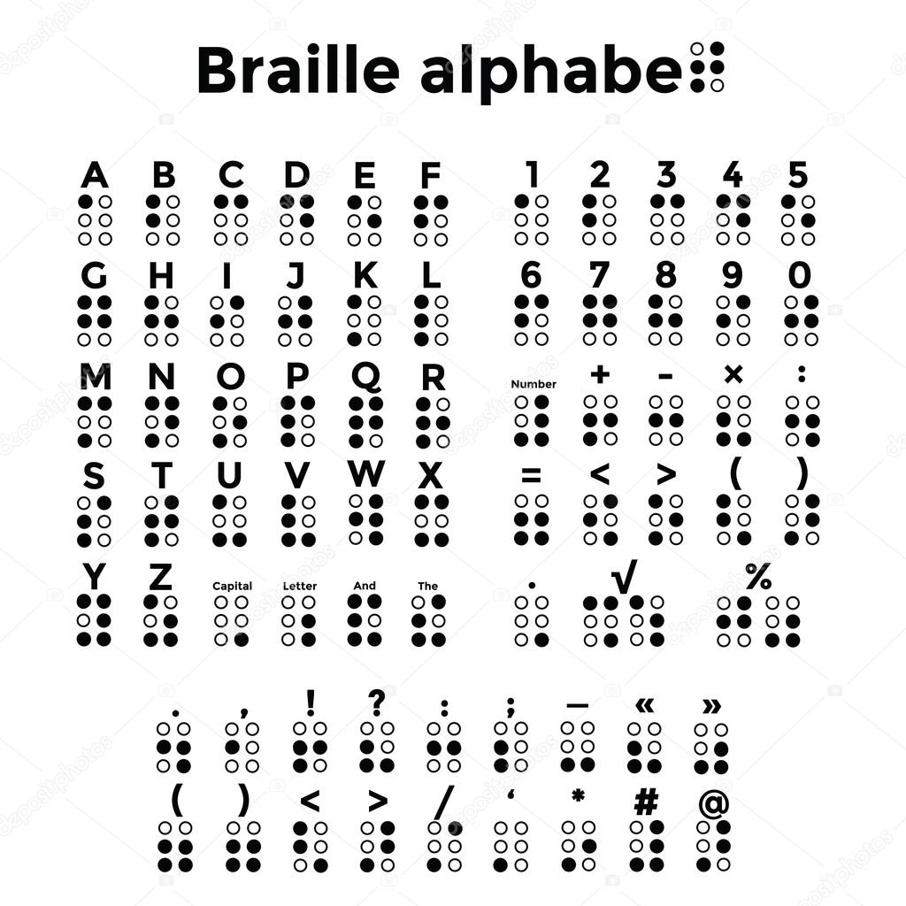
Braille
Braille symbols are formed within units of space containing six dots known as braille cells.
Sixty-four combinations are possible using one or more of these six dots.
A single cell can be used to represent an alphabet letter, number, punctuation mark, or even a whole word.

Slide 29
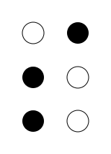

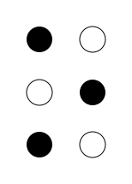
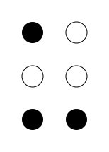
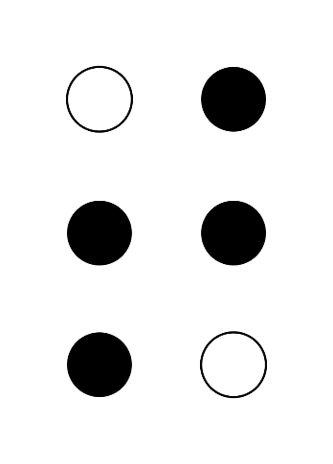
Braille
_______ _______ _______ _______ _______ _______
Decode the above message.

Slide 30
Requirement 6
Do the following:
  Describe to your counselor six sound-only signals that are in use today. Discuss the pros and cons of using sound signals versus other types of signals.
  Demonstrate to your counselor six different silent Scout signals. Use these Scout signals to direct the movements and actions of your patrol or troop.

Slide 31
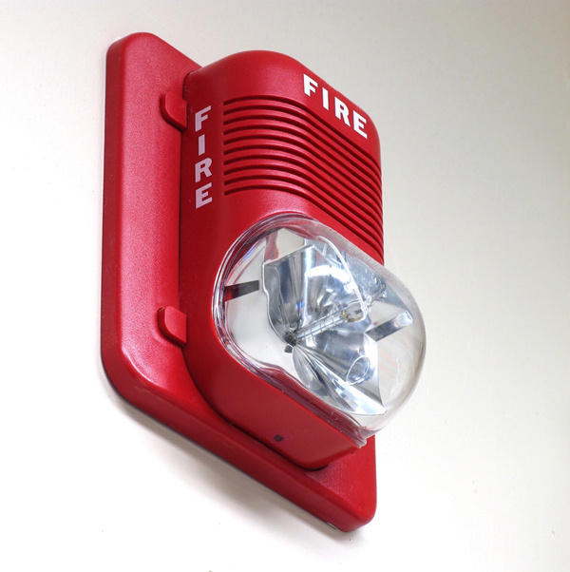
Sound Signals
Fire Alarm
Trains
Boating signals
Ambulance/police siren
School bells
Back-up alarms

Slide 32
Pros and Cons of Sound Signals
Pros | Cons
Can convey information and warnings very quickly e.g. a fire bell. | Need to know what the sound signal represents in order to understand the information/message.
Sounds are accessible and understandable by people no matter what language they speak. | People with poor hearing might not be able to access the information.
Can convey information to many people at once. | Can be distracting especially if people are trying to concentrate.
Humans are sensitive to sound and will often pick information conveyed by sound above other methods.

Slide 33
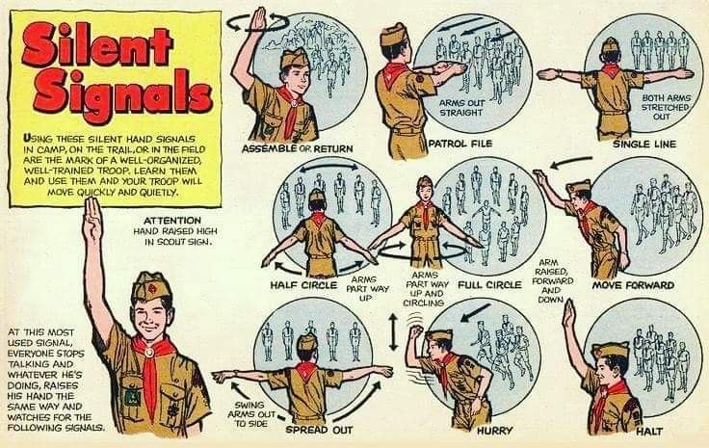
Silent Scout Signals

Slide 34
Requirement 7
On a Scout outing, lay out a trail for your patrol or troop to follow. Cover at least one mile in distance and use at least six different trail signs and markers. After the Scouts have completed the trail, follow no-trace principles by replacing or returning trail markers to their original locations.

Slide 35
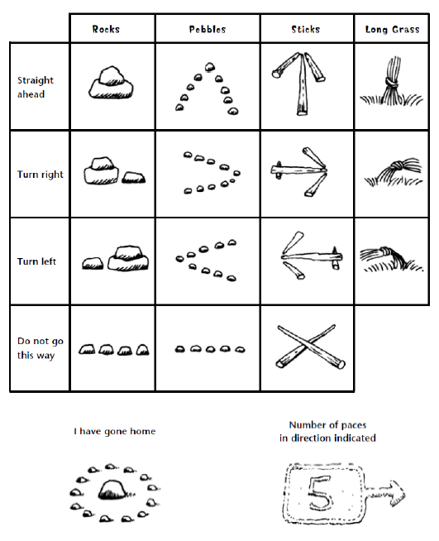
Trail Markers

Slide 36
Requirement 8
For THREE of the following activities, demonstrate five signals each. Tell what the signals mean and why they are used:
  Sports official's hand signs/signals
  Heavy-equipment operator's hand signals
  Aircraft carrier catapult crew signals
  Cyclist's hand signals
  An activity selected by you and your counselor

Slide 37
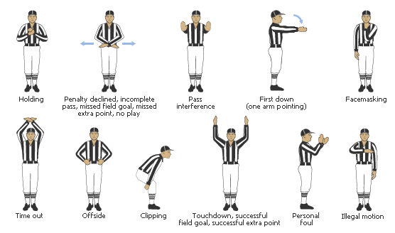
Sports Official's Hand Signs/Signals: Football

Slide 38
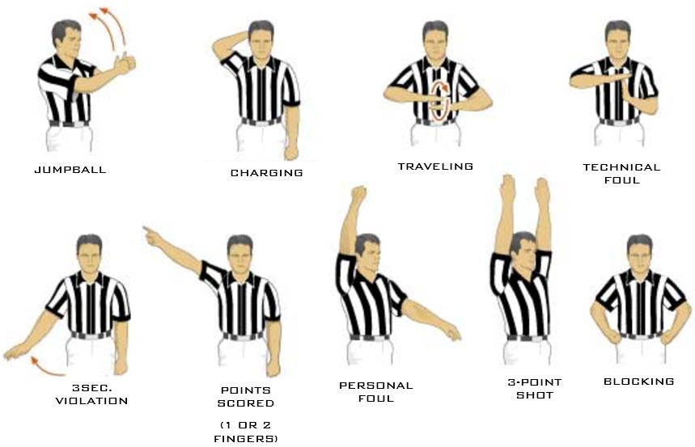
Sports Official's Hand Signs/Signals: Basketball

Slide 39
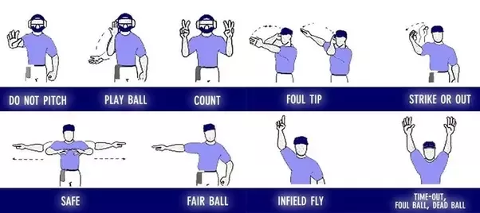
Sports Official's Hand Signs/Signals: Baseball/Softball

Slide 40
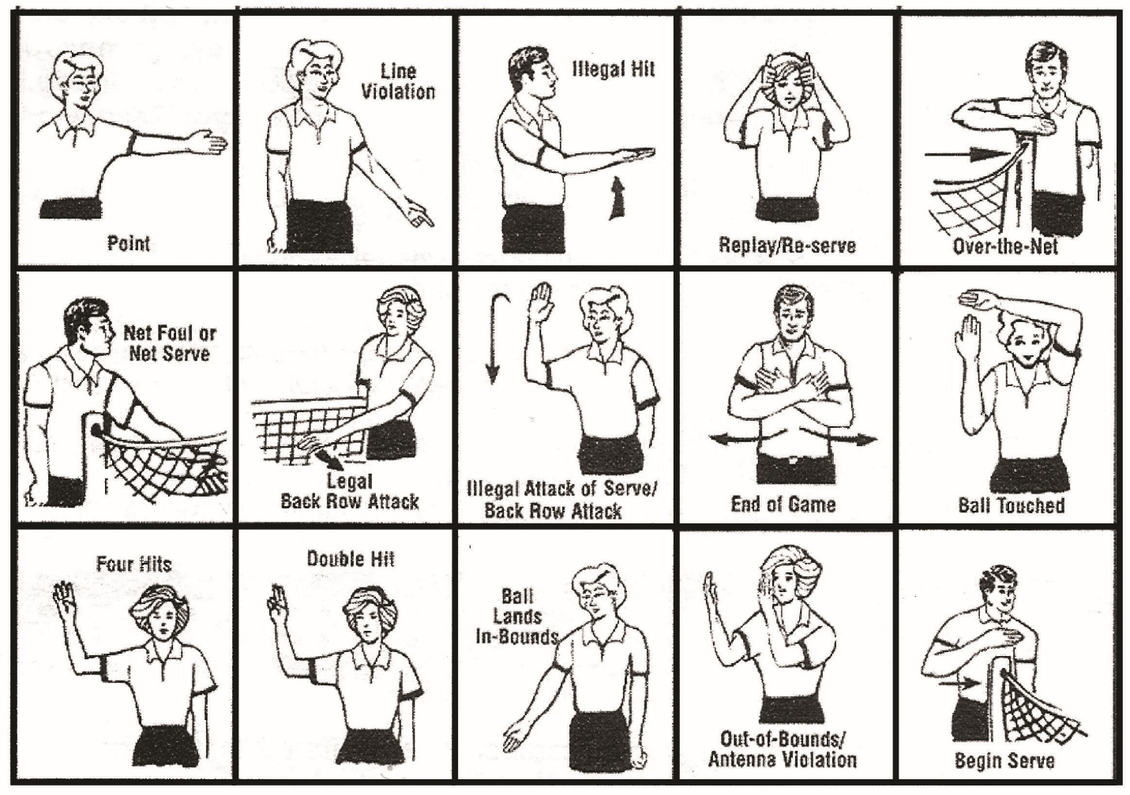
Sports Official's Hand Signs/Signals: Volleyball

Slide 41
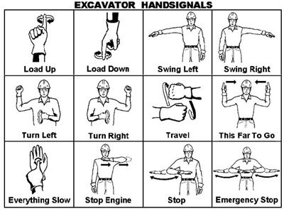
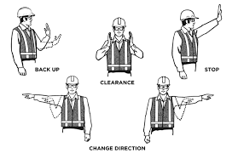
Heavy-Equipment Operator's Hand Signals
Excavator Hand Signals
Spotter Hand Signals

Slide 42
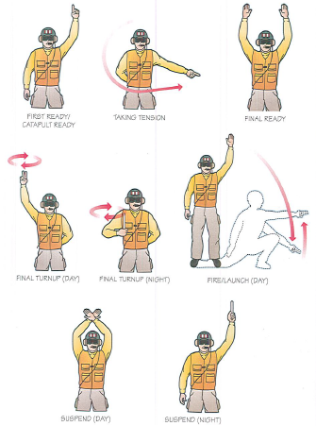
Aircraft Carrier Catapult Crew Signals

Slide 43
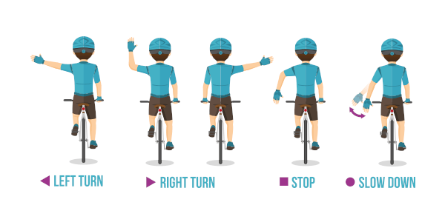
Cyclist's Hand Signals

Slide 44
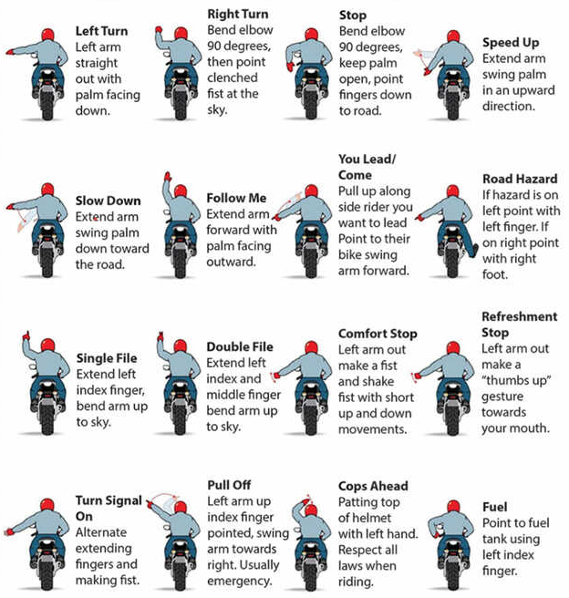
Motorcycle Hand Signals

Slide 45
Requirement 9
Share with your counselor 10 examples of symbols used in everyday life. Design your own symbol. Share it with your counselor and explain what it means. Then do the following:
  Show examples of 10 traffic signs and explain their meaning.
  Using a topographical map, explain what a map legend is and discuss its importance. Point out 10 map symbols and explain the meaning of each.
  Discuss text-message symbols and why they are commonly used. Give examples of your favorite 10 text symbols or emoticons. Then see if your counselor or parent can identify the meaning or usage of each symbol.

Slide 46
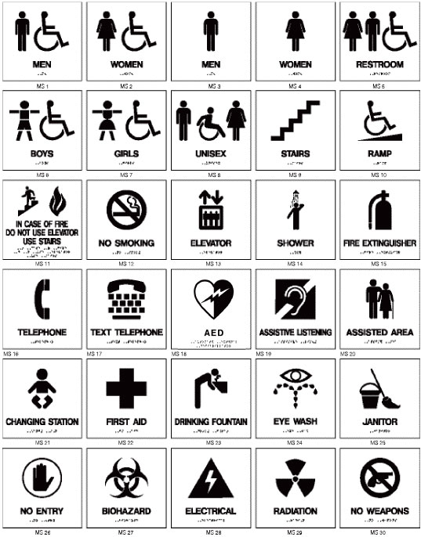
Everyday Symbols

Slide 47


5 Cardinal Rules of Symbol Design
Your symbol should reflect your idea in a unique and honest way.
  Your symbol should relate to the idea you are trying to express.
Avoid too much detail.
  Simple symbols are recognized faster than complex ones. Strong lines and letters show up better than thin ones, and clean, simple symbols reduce and enlarge much better than complicated ones.
Your symbol should work well in black and white (one-color printing).
  If it doesn't look good in black and white, it won't look good it any color.
Make sure your symbol is scalable.
  It should be aesthetically pleasing in both small and large sizes as well as in a variety of mediums.
Your symbol should be artistically balanced.
  The best way to explain this is that your symbol should seem "balanced" to the eye--no one part should overpower the rest.
  Just as a painting would look odd if all the color and details were segregated in one corner, so do asymmetric symbols.
  Color, line density and shape all affect a symbol's balance.

Slide 48
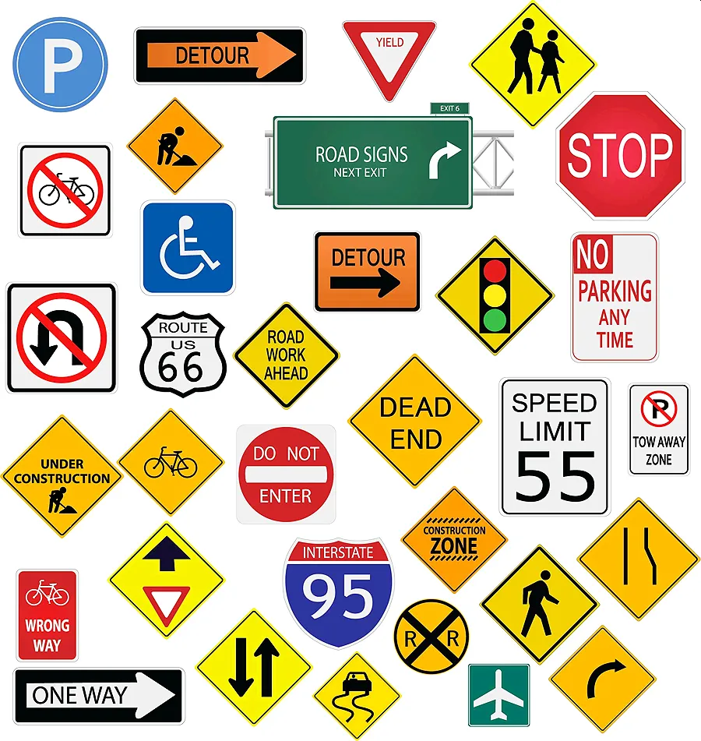
Traffic Signs

Slide 49

Topographic Map Legend
A map legend is a description, explanation, or table of symbols printed on a map or chart to permit a better understanding or interpretation of it.
Map legends usually contain information on the map scale as well.

Slide 50
Topographic Map Colors
In general these are the major color categories used on USGS topo maps.
Brown lines – contours (note that intervals vary)
Black lines – roads, railroads, trails, and boundaries
Red lines – survey lines (township, range, and section lines)
Blue areas – streams and solid is for larger bodies of water
Green areas – vegetation, typically trees or dense foliage
Pink or light gray areas – cities and dense buildings (“built-up areas”)
Purple areas – used to show what was new on the latest editions of their maps (USGS no longer does this but it is still on some maps)

Slide 51
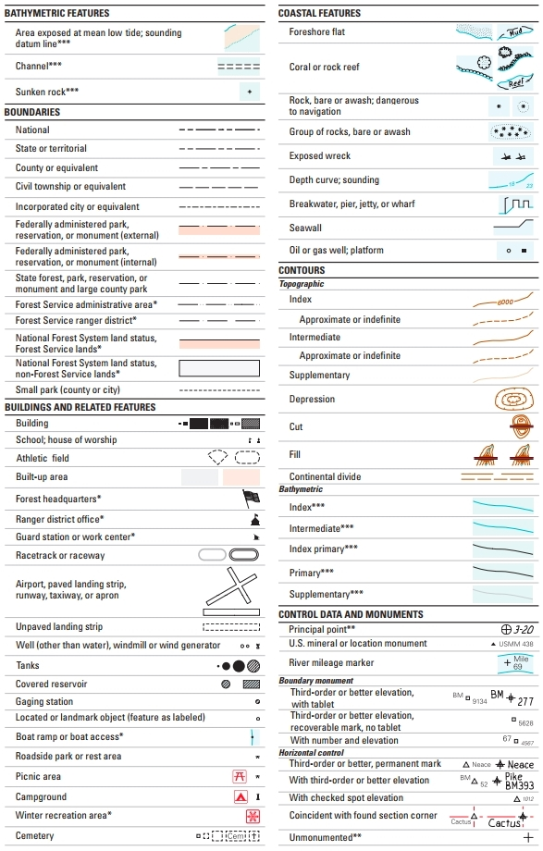
Topographic Map Symbols

Slide 52
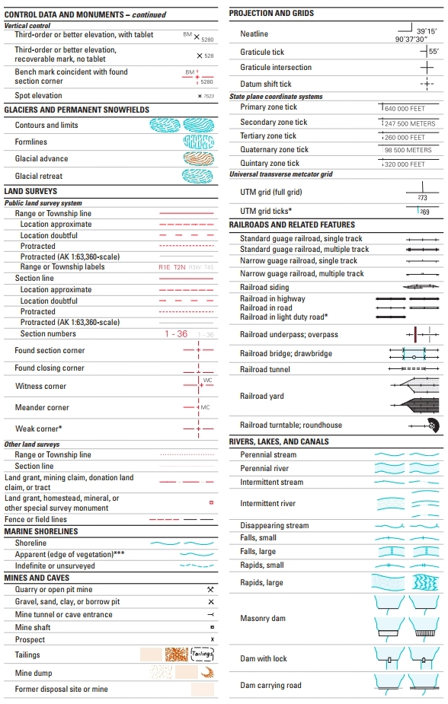
Topographic Map Symbols

Slide 53
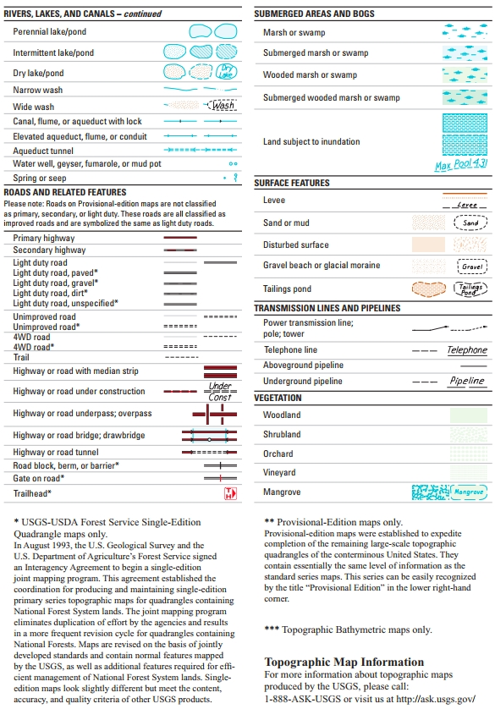
Topographic Map Symbols

Slide 54
Text Message Symbols
When you're typing with your thumbs, you need to save your effort by communicating with as few letters as possible. Consequently, users created text message symbols as a sort of shorthand to make texting easier and faster. Most symbols make sense and have become a mainstay in texting language.
Emoticons are pictures or faces made from characters on a cell phone's keypad. You may choose to send emoticons to express your mood or add some humor or personality to a message rather than typing out an entire message.

Slide 55
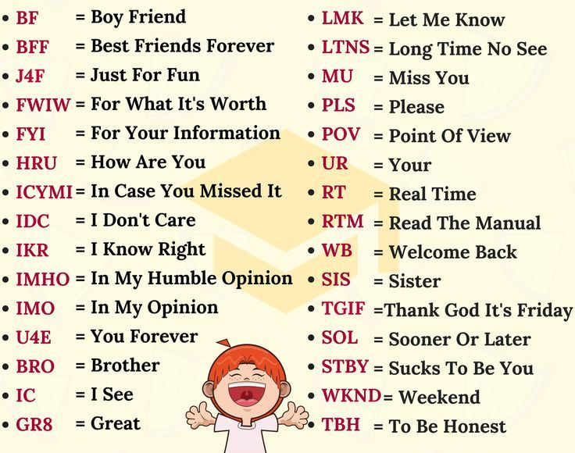
Texting Abbreviations

Slide 56
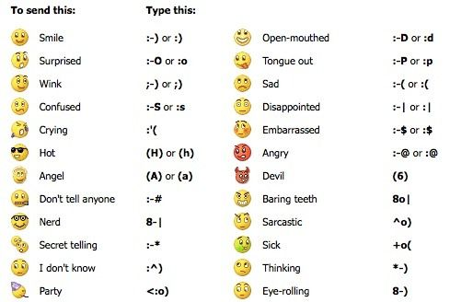
Text Emoticons

Slide 57
Requirement 10
Briefly discuss the history of secret code writing (cryptography). Make up your own secret code and write a message of up to 25 words using this code. Share the message with a friend or fellow Scout. Then share the message and code key with your counselor and discuss the effectiveness of your code.

Slide 58
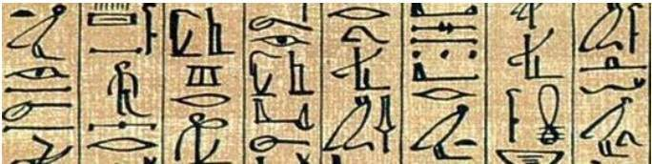
History of Cryptography
Hieroglyph − The Oldest Cryptographic Technique
The first known evidence of cryptography can be traced to the use of ‘hieroglyph’. Some 4000 years ago, the Egyptians used to communicate by messages written in hieroglyph. This code was the secret known only to the scribes who used to transmit messages on behalf of the kings. One such hieroglyph is shown below.

Slide 59
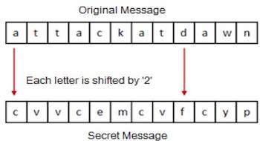
History of Cryptography
Later, the scholars moved on to using simple alphabetic substitution ciphers during 500 to 600 BC. This involved replacing alphabets of message with other alphabets with some secret rule. This rule became a key to retrieve the message back from the garbled message.
An early Roman method of cryptography, popularly known as the Caesar Shift Cipher, relies on shifting the letters of a message by an agreed number (three was a common choice), the recipient of this message would then shift the letters back by the same number and obtain the original message.

Slide 60

History of Cryptography
The Italian philosopher and architect Leon Batista Alberti invented a cipher disk in 1467.
He used two different alphabets arranged in two rings, with the larger ring encircling the smaller one.
Lining up a letter from one ring with a different letter in the other ring created a simple substitution cipher that could be used to encrypt or decrypt a message.

Slide 61

History of Cryptography
In the early 18th century, the Freemasons began using a cipher commonly known as the “pigpen cipher” to keep their records and communications private.
The method replaces letters with symbols that are fragments of a grid.

Slide 62

History of Cryptography
Thomas Jefferson invented a cipher wheel in the early 1790’s.
The device had a set of wooden disks, each with the 26 letters of the alphabet arranged around its edge.
The order of the letters was random and different on each disk.
To use the Wheel Cypher, both parties must have one and must decide beforehand how to orient the wheels so that messages can be sent and decoded.

Slide 63

History of Cryptography
Only after the 19th century, cryptography evolved to the more sophisticated art and science of information security.
In the early 20th century, the invention of mechanical and electromechanical machines, such as the Enigma rotor machine, provided more advanced and efficient means of coding the information.
During the period of World War II, both cryptography and cryptanalysis became excessively mathematical.
Enigma Rotor Machine

Slide 64

Creating Your Own Code
To create your own secret code, you can use any of the methods discussed or do research to find the code system you want to use, or make up your own code.
Whatever type of encryption you use, you must also make a key that gives instructions or shares the secret for deciphering the messages you write in that code.
Give the key to the recipients of your messages so they will know how to convert the coded text back to the original message.

